Slide 1
DYNAMO DB
Amazon DynamoDBA fast and flexible NoSQL database service for any scaleDynamoDB is a fully managed, key-value, and document database that delivers single-digit-millisecond performance at any scale.

Slide 2
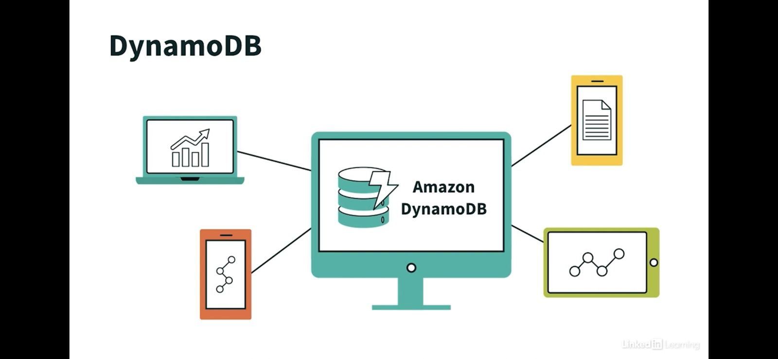

Slide 3
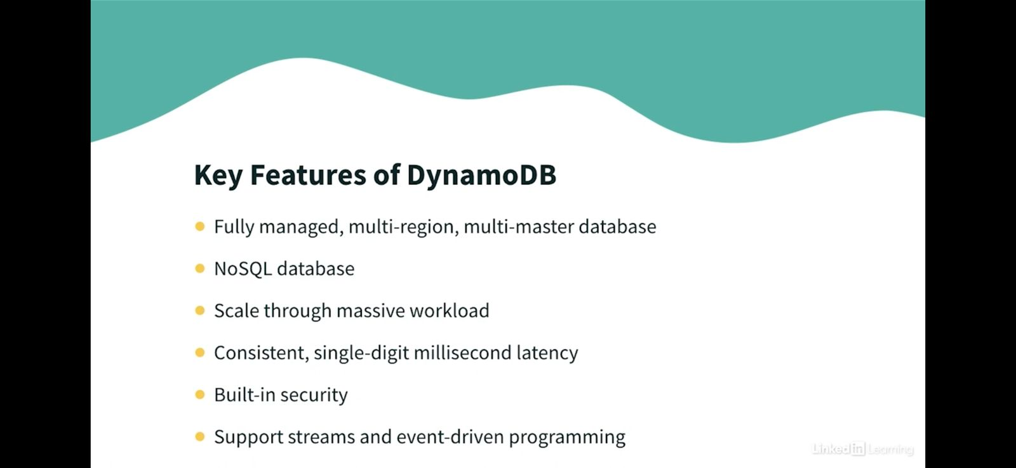

Slide 4


Slide 5
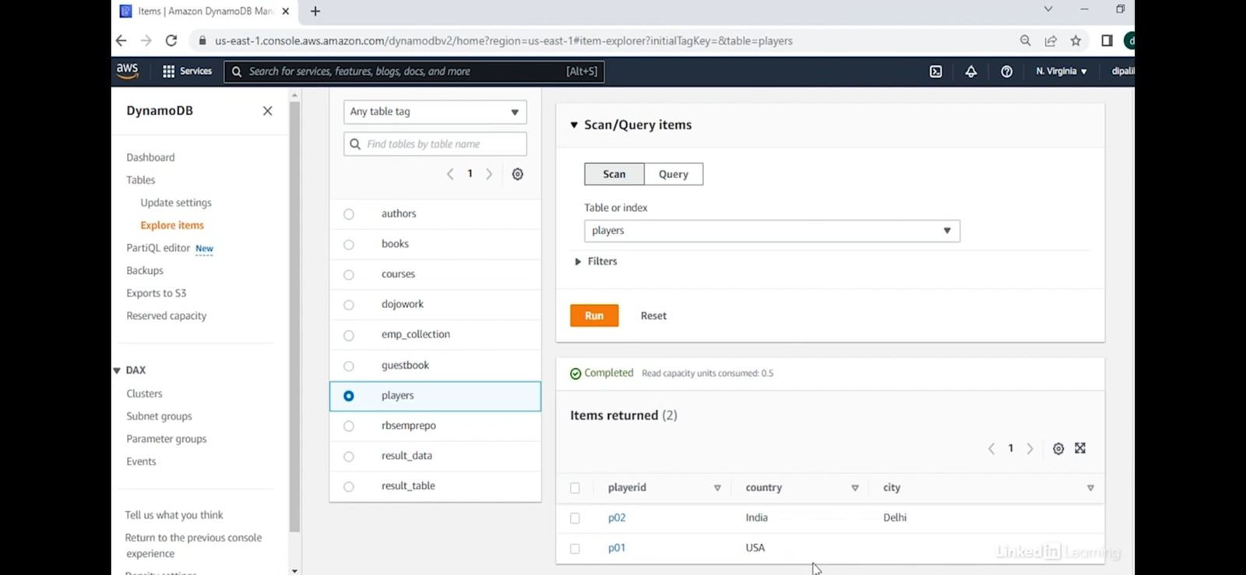

Slide 6
